Slide 1
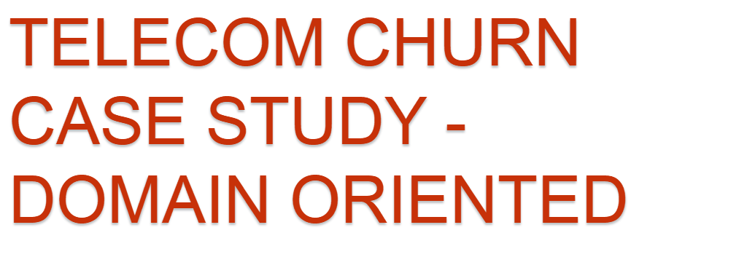
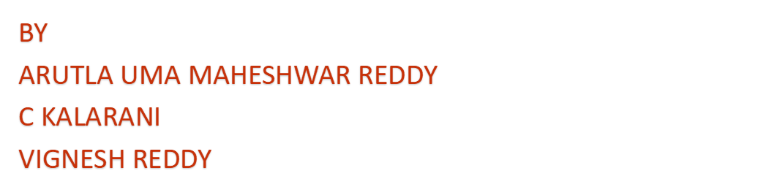

Slide 2
In the telecom industry customers are able to choose multiple service providers and actively switch from one operator to another. In this highly competitive market, the tele communications industry experiences an average annual churn rate of 15-25%. Given the fact that it costs 5-10 times more to acquire a new customer than to retain an existing one.
Customer retention has now become even more important than customer acquisition.
To reduce customer churn, telecom companies need to predict which customers are at high risk of churn.
In this study, you will analyse customer-level data of a leading telecom firm, build predictive models to identify customers at high risk of churn and identify the main indicators of churn.
PROBLEM STATMENT

Slide 3

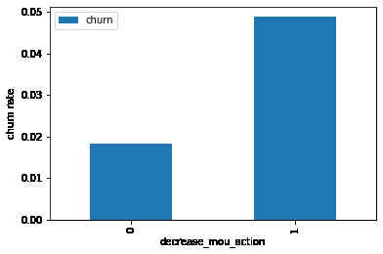
Churn rate was decided based on the customer
usage ie. Minutes of usage in the action
month.
Customers whose minutes of usage (MoU)
decreased in the action phase have a higher
churn rate than those whose minutes of usage
increased in the good phase.

Slide 4

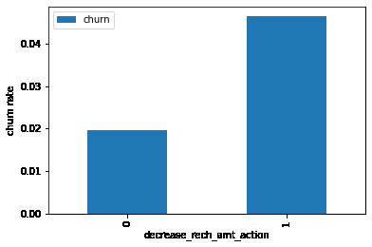
Churn rate on the basis whether
the customer decreased her/his
volume based cost in action
month.
The churn rate is more for the
customers, whose amount of
recharge in the action phase is
lesser than the amount in good
phase.

Slide 5

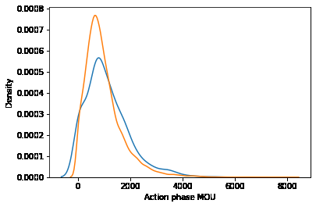
Analysis of the minutes of usage
MoU (churn and not churn)
in the action phase
Minutes of usage(MOU) of the churn customers
is mostly populated on the 0 to 2500 range.
Higher the MOU, lesser the churn probability.

Slide 6
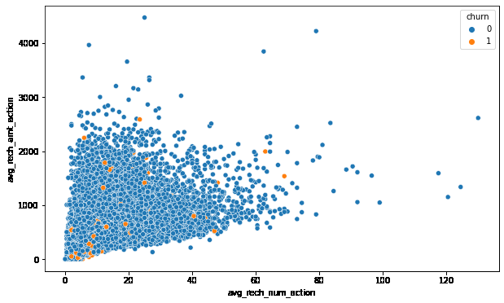
ANALYSIS BASED ON RECHARGE
Analysis of recharge amount
and number of recharge in
action month
We can see from the above pattern that
the recharge number and the recharge
amount are mostly propotional. More the
number of recharge, more the amount of
the recharge.

Slide 7
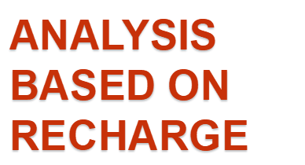
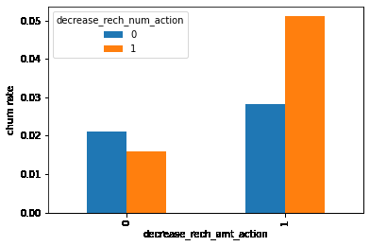
Analysis of churn rate by the
decreasing recharge amount
and number of recharge in
the action phase
We can see from the above plot, that the
churn rate is more for the customers,
whose recharge amount as well as
number of recharge have decreased
in the action phase than the good phase.

Slide 8
CONCLUSION AND SUGGESTION
Target the customers, whose minutes of usage of the incoming local calls and outgoing ISD calls are less in the action phase (mostly in the month of August).
Target the customers, whose outgoing others charge in July and incoming others on August are less.
Furthermore, the customers having value based cost in the action phase increased are more likely to churn than the other customers. Hence, these customers may be a good target to provide offer.
Cutomers, whose monthly 3G recharge in August is more, are likely to be churned.
Customers having decreasing STD incoming minutes of usage for operators T to fixed lines of T for the month of August are more likely to churn.
Cutomers decreasing monthly 2g usage for August are most probable to churn.
Customers having decreasing incoming minutes of usage for operators T to fixed lines of T for August are more likely to churn.
roam_og_mou_8 variables have positive coefficients (0.7135). That means for the customers, whose roaming outgoing minutes of usage is increasing are more likely to churn.

Slide 9
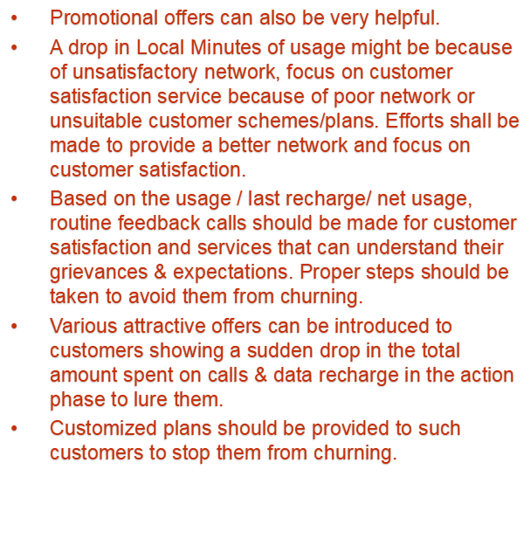
Following strategies can be implemented

